Slide 1
19CSE202 Data Base Management System
Project Title: Data Base Management System on Theatre Management
Team Members:
1)Mahita Kandala- BL.EN.U4CSE20091
2)Likesh K- BL.EN.U4CSE20086
3)Puneeth Kumar Oyyavuru- BL.EN.U4CSE20133
4)Aashritha Srivani T- BL.EN.U4CSE20185

Slide 2
Agenda
Abstract
ER Diagram
Table Conversion
Presentation(Module Explanation)
Demo

Slide 3
Abstract
In this project we will try to bring forward a platform which will show the user the available movies and further information related to it like genre, ratings, film certifications
The viewers can then book their seats according to their preferences through this very platform in a specified theater according to the availability of seats.
On the theater employee’s side, we would incorporate a feature to delete and update the movie list and seats available.
This project will contain various tables for its functioning as described above. Some tables to take into major consideration will be Movies table, Shows table, Admin table and Customer table.
Front end architecture will be majorly handled using HTML, CSS, JavaScript.
Backend will be handled with the help of applications StarUML, PHP and SQL.

Slide 4
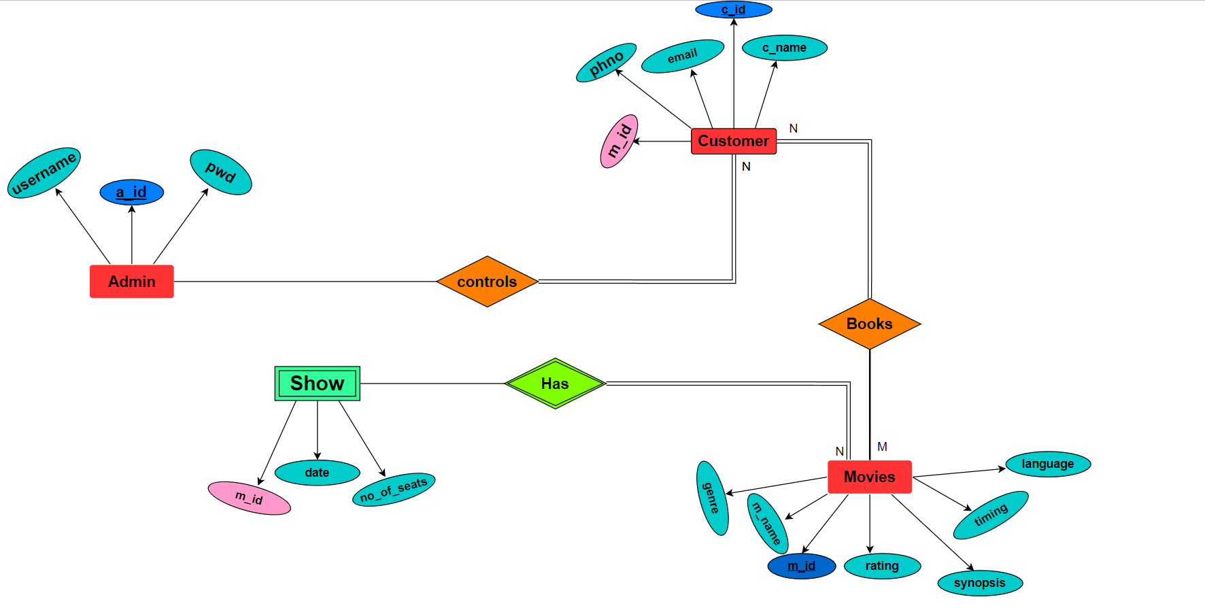
ER Diagram

Slide 5
Table Conversion
Tables To Be Created:
Customer(c_id PK, c_name, email, phno, m_id FK)
Admin(a_id PK, username, pwd)
Show(m_id, date, no_of_seats)
Movies(m_id PK, m_name, imdb_rating, synopsis, language, genre)

Slide 6
Table Conversion
Customer(c_id PK, c_name, email, phno, m_id FK)
CREATE TABLE `customer` (
`c_id` int(11) NOT NULL AUTO_INCREMENT,
`c_name` varchar(50) NOT NULL,
`email` varchar(50) NOT NULL,
`phno` varchar(10) NOT NULL,
`m_id` varchar(100) NOT NULL,
UNIQUE KEY `c_id` (`c_id`),
UNIQUE KEY `c_id_2` (`c_id`)) ENGINE=InnoDB AUTO_INCREMENT=14 DEFAULT CHARSET=utf8mb4;
2. Admin(a_id PK, username, pwd)
CREATE TABLE `admin` (
`adno` int(11) NOT NULL,
`username` varchar(25) NOT NULL,
`pwd` varchar(25) NOT NULL,
PRIMARY KEY (`adno`)
) ENGINE=InnoDB DEFAULT CHARSET=utf8mb4;

Slide 7
Table Conversion
3.Movies(m_id PK, m_name, rating, synopsis, language, timing, genre)
CREATE TABLE `movies` (
`m_id` varchar(10) NOT NULL,
`m_name` varchar(50) NOT NULL,
`genre` varchar(100) DEFAULT NULL,
`imdb_rating` decimal(10,1) DEFAULT NULL,
`synopsis` varchar(500) DEFAULT NULL,
`lang` varchar(10) NOT NULL DEFAULT 'Hindi',
PRIMARY KEY (`m_id`),
UNIQUE KEY `m_id` (`m_id`),
KEY `m_id_2` (`m_id`)
) ENGINE=InnoDB DEFAULT CHARSET=utf8mb4;
4. Show(m_id , date, no_of_seats)
CREATE TABLE `shows` (
`m_id` varchar(10) NOT NULL,
`date` date NOT NULL,
`seats` int(11) NOT NULL DEFAULT 100
) ENGINE=InnoDB DEFAULT CHARSET=utf8mb4;

Slide 8
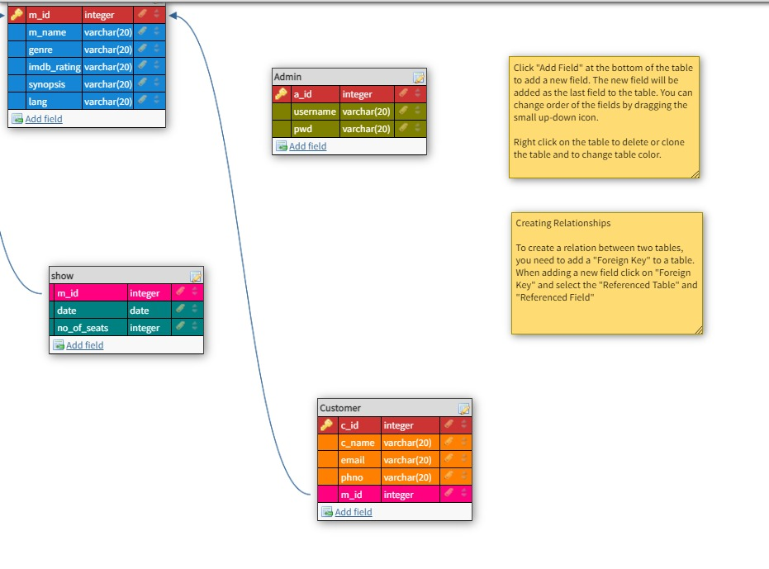
Schema

Slide 9
Module Explanation
The very first page in our project consists of the Theatre name and three clickable buttons where it takes us to the Admin Login Page, Movies Page and Customer login page respectively.
Admin Login Page: Its basically the backend users page
1)After logging in through the Admin page, we have Moderators Page that consists of following:
View Movie List Currently Playing - Displays the list of movies that are playing(Backend - phpmyadmin)
Insert New Movie - Inserts new movie with all the contents of the Movies table(Backend - phpmyadmin)
Delete Movie Playing - Deletes the movie in the theatre(Backend - phpmyadmin)
And also, we have Movies and About Us page linked with it.

Slide 10
Module Explanation contd …
Movies Page:
The List of movies will be displayed, after clicking on Movies button in the main page.
Under each movie, you can find description of the movie as well as an option called “BOOK TICKETS”, if you want to book your tickets, click on it and you will be redirected to the page where you can find the quick summary about the movie and also it asks us to enter the details of the Booking, like Date, no.of.seats, Name, Phone Number,Email-ID.

Slide 11
Module Explanation contd …
Customer Login Page: After logging, it takes us to the page where we can see whether we booked any tickets, If no, it displays no results found on Movies you booked page
If we book tickets, then it shows Movie name, ratings, genre, Synopsis and language of the movie and name of the customer along with his/her phone number.

Slide 12

DEMO

Slide 13
THANK YOU, Its really amazing doing this project, we have learnt many new things, thanks for the opportunity, ma’am

